Slide 1

OBJECT DETECTION
Sabbiu Shah
Sagar Adhikari
Samip Subedi

Slide 2
Vision
Acquiring
Processing
Understanding

Slide 3
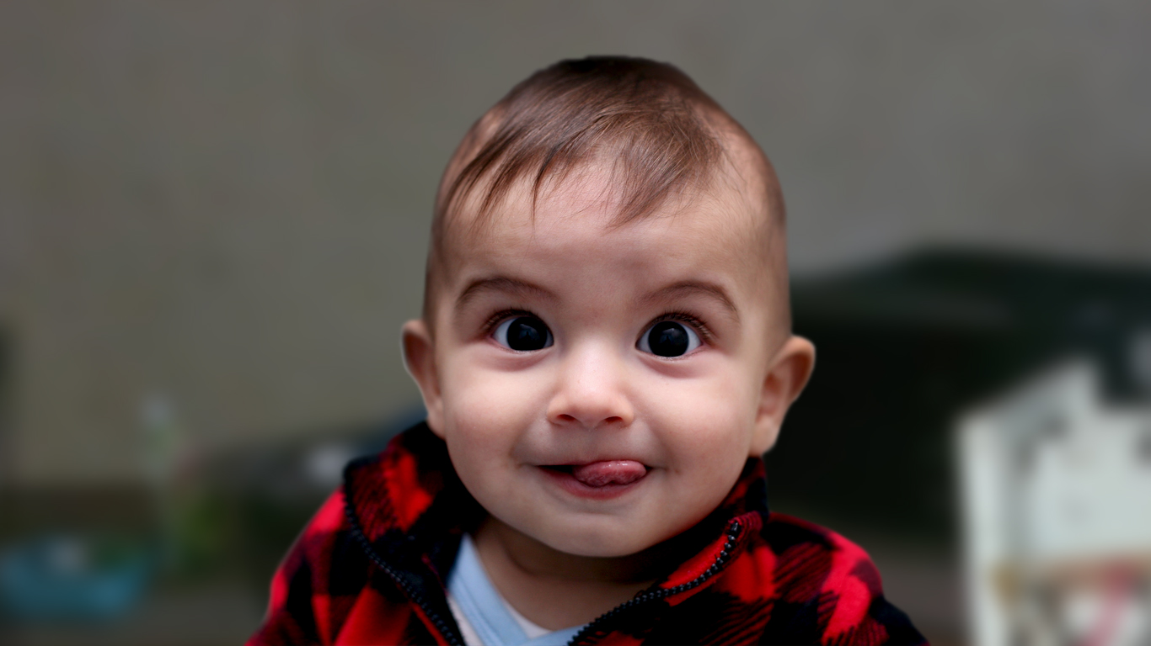
What we see

Slide 4
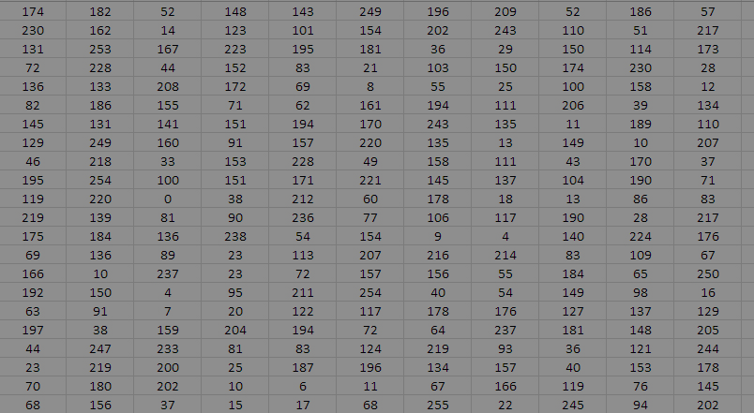
What Computer sees

Slide 5

Computer Vision

Slide 6
Computer Vision
Task that include methods for Acquiring, processing and understanding digital images by Computer.

Slide 7
Computer Vision
Based on Numerical or Symbolic information.

Slide 8
Computer Vision

Slide 9
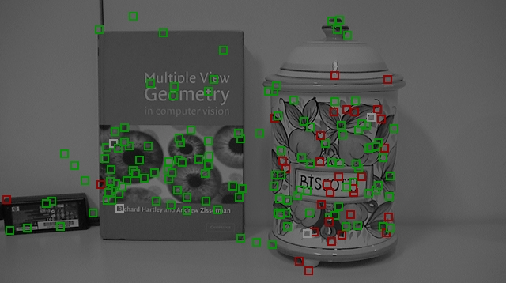
Object Detection

Slide 10
Object Detection
Field of Computer Vision

Slide 11
Object Detection
Focuses on “Where”
rather than “What”

Slide 12

Our Objectives

Slide 13
Objectives

Slide 14
Objectives

Slide 15
Objectives

Slide 16
Methodology
Feature Descriptor (SIFT)
K-means Clustering
Support Vector Machine (SVM) classifier
Localization
Reinforcement Learning

Slide 17
Features Descriptor(SIFT)
Very popular feature Extraction Algorithm proposed by David Lowe in 1999
Invariant to
Scale
Orientation
Ilumination
ViewPoint

Slide 18
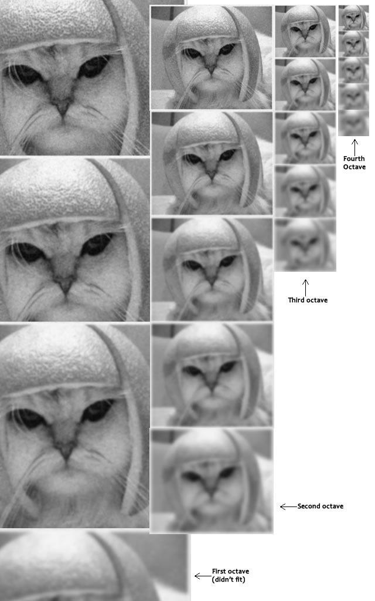
Features Descriptor(SIFT)
5 Scales(Blur Levels) and 4 octaves ideal for the algorithm
Gaussian Blur

Slide 19
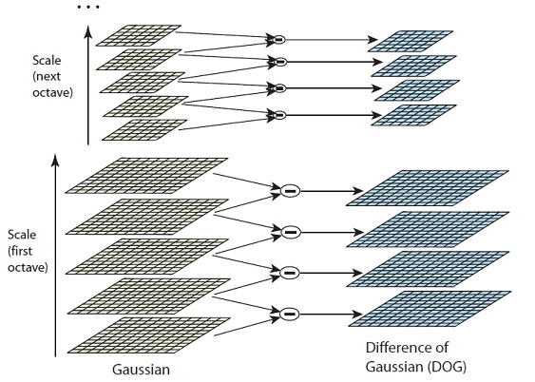
Features Descriptor(SIFT)
Difference between two consecutive Scales to generate DoG(Difference of Gaussian) Images

Slide 20
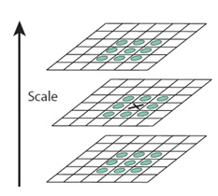
Features Descriptor(SIFT)
Locate maxima/minima in DoG images
X is marked as a "key point" if it is the greatest or least of all 26 neighbours

Slide 21
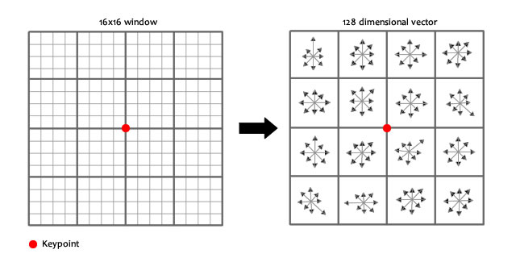
Features Descriptor(SIFT)
Creates a 16x16 window around the keypoint. This 16x16 window is broken into sixteen 4x4 windows.
Within each 4x4 window, calculates gradients and puts into 8 bin histogram.

Slide 22
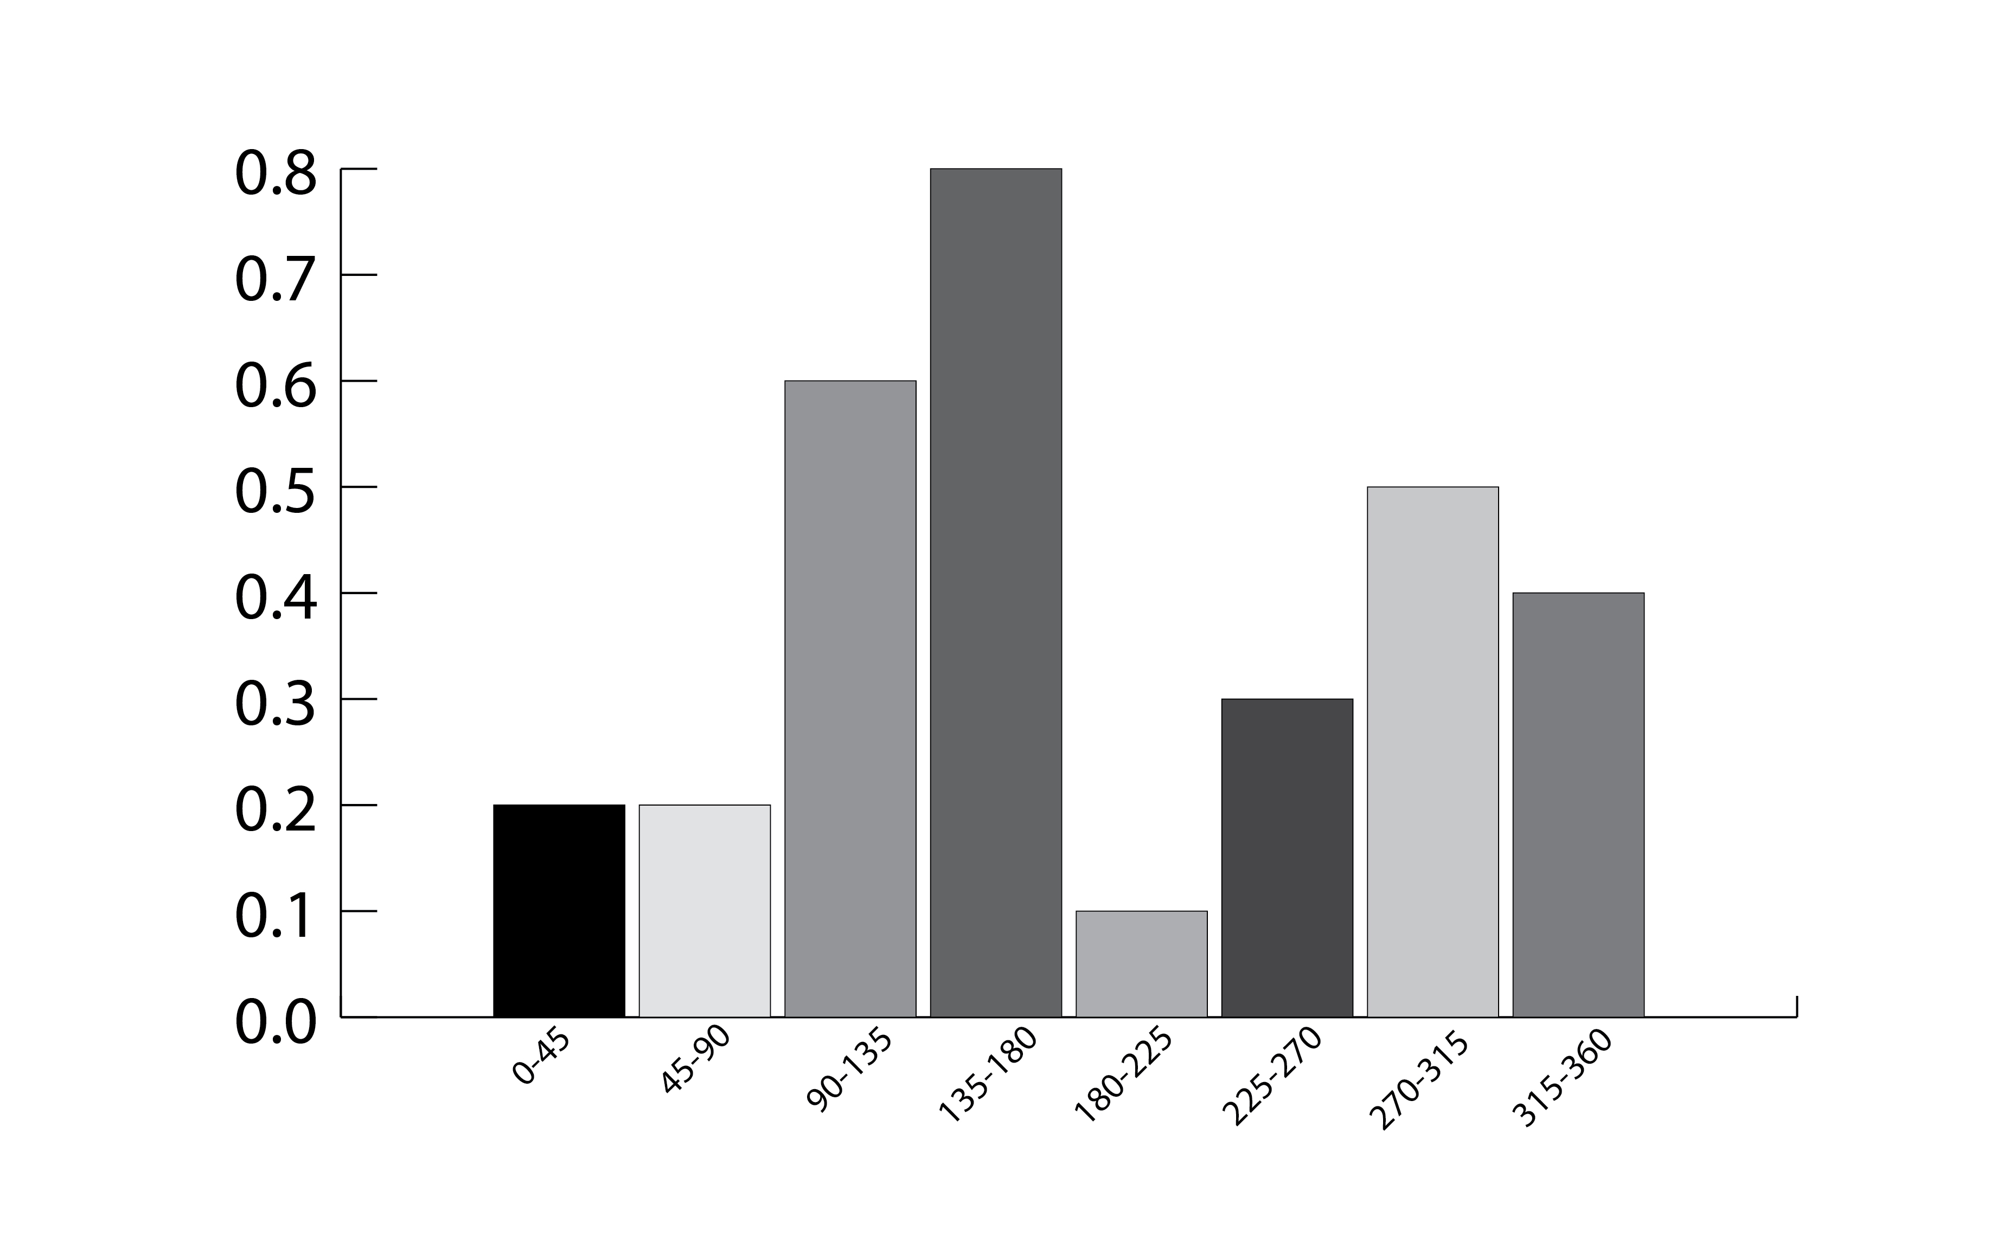
Features Descriptor(SIFT)
8 bin histogram for each 4*4 window
16x8=128 numbers to describe a keypoint(feature)
Thus each feature point is a 128 dimensional vector.

Slide 23
K-MEANS CLUSTERING
Suppose, Number of training images=200
Number of feature extracted from each image=100
Total number of feature points= 200,100.
Very large for computation
Use K-MEANS Clustering

Slide 24
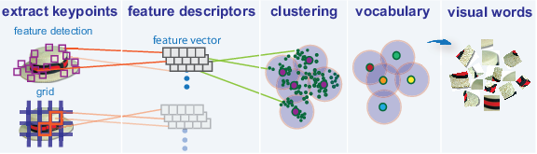
K-MEANS CLUSTERING
Unsupervised Machine Learning Algorithm
Creates Bag Of Words Model

Slide 25
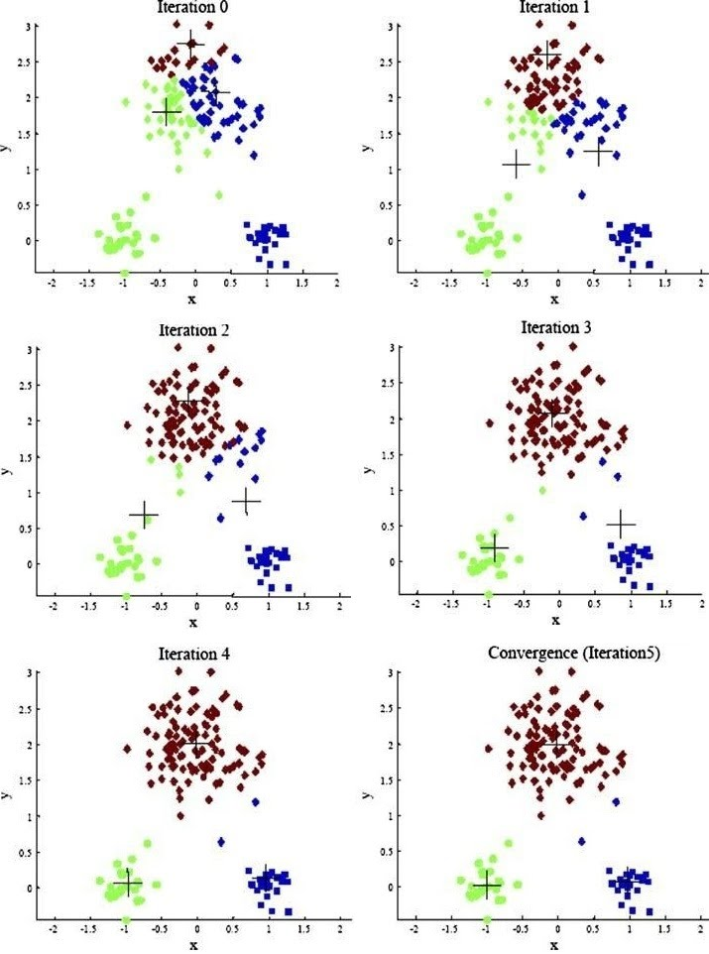
K-MEANS CLUSTERING
Here K=3
Initially randomly 3 cluster points are chosen.
In each iteration cluster center becomes more accurate
K=500 (for our purpose)

Slide 26
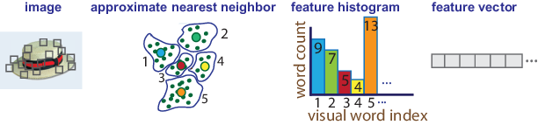
BAG OF VISUAL WORDS
Since K=500, Bag of Words created=500
One histogram for each training image using BoW model.
500 dimensional feature vector for each image
[9,7,5,4,13,……….]

Slide 27
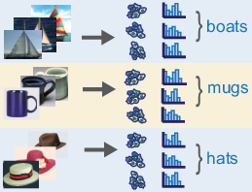
FEATURE HISTOGRAMS
Finally we have single histogram vector for each image of each class.
Histograms are normalized to make this process invariant to number of descriptors used .

Slide 28
SVM CLASSIFIER
SUPPORT VECTOR MACHINE
Why?
Compared to other techniques, we get clearer and more powerful way of learning complex non-linear function.

Slide 29
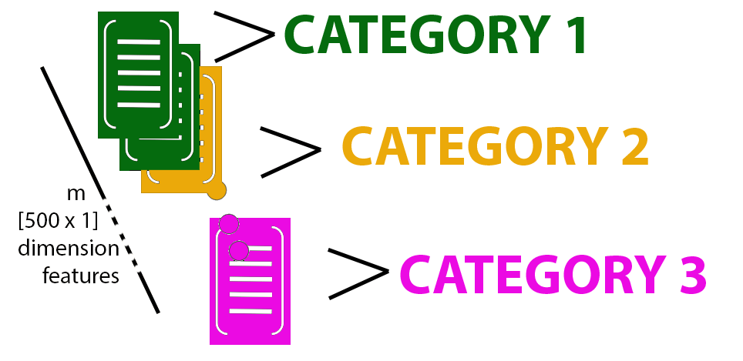
SVM CLASSIFIER

Slide 30

SVM CLASSIFIER
Label 1
Label 2
Label 3
500 dimension

Slide 31
SVM CLASSIFIER
CATEGORIES | LABEL 1 | LABEL 2 | LABEL 3
CATEGORY 1 | Positive Image | Negative Image | Negative Image
CATEGORY 2 | Negative Image | Positive Image | Negative Image
CATEGORY 3 | Negative Image | Negative Image | Positive Image

Slide 32
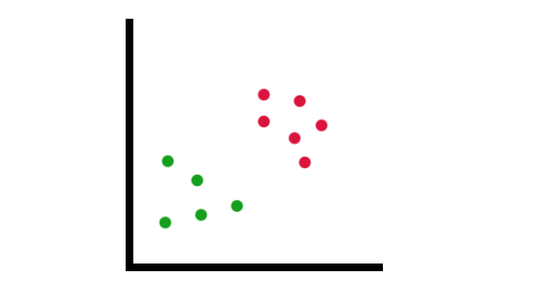
SVM CLASSIFIER
F1
F2
F3
.
.
.
.
.
.
Fm
Similarity of features (x) with landmarks (l),
F_{i} = exp ₍ - || x – l^{(i)} ||² ₎
X2
2 ²
If x  l(i),
F = exp (0) = 1
If x is far away from l(i)
F = exp (large no.) = 0
X1

Slide 33
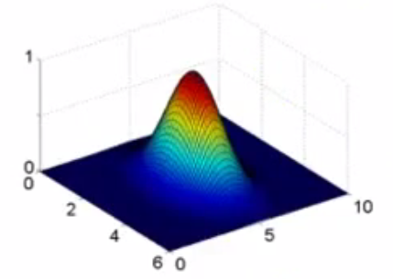
SVM CLASSIFIER
F = exp (0) = 1
F = exp (large no.)
= 0
Varying the value of sigma controls variance.

Slide 34
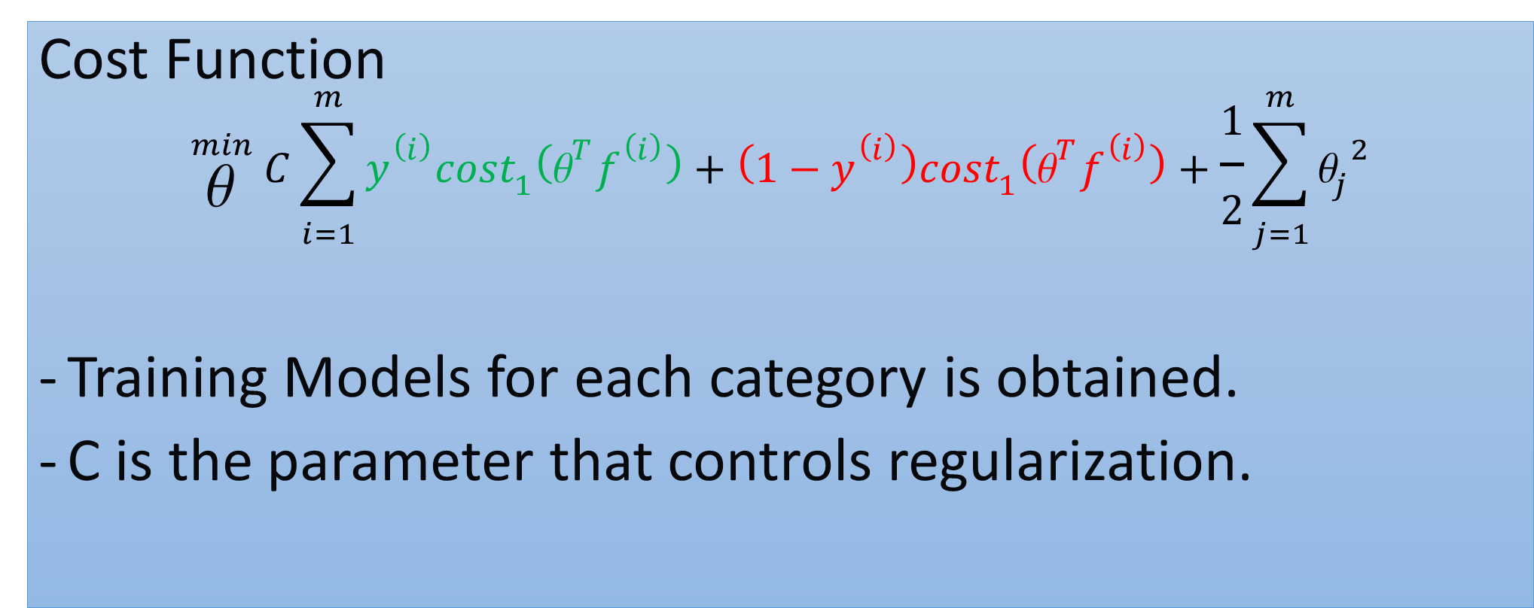
SVM CLASSIFIER
Cost Function
$${}_{θ }^{min}{ C\sum_{i=1}^{m}{y^{\left(i\right)}{cost}_{1}\left(θ^{T}f^{\left(i\right)}\right)}+ }\left(1−y^{\left(i\right)}\right){cost}_{1}\left(θ^{T}f^{\left(i\right)}\right)+\frac{1}{2}\sum_{j=1}^{m}{{θ_{j}}^{2}}$$
Training Models for each category is obtained.
C is the parameter that controls regularization.

Slide 35
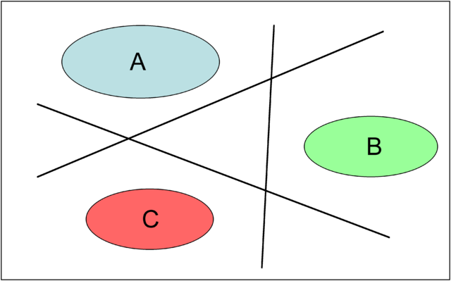
SVM CLASSIFIER
Finally, we will get models for each category.

Slide 36
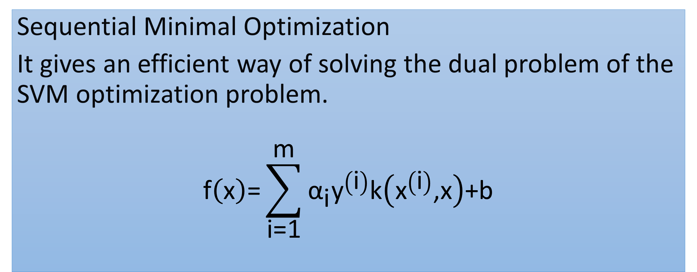
SMO
Sequential Minimal Optimization
It gives an efficient way of solving the dual problem of the SVM optimization problem.
$$\text{f}\left(\text{x}\right)\text{=}\sum_{\text{i}\text{=1}}^{\text{m}}{{\text{α}}_{\text{i}}{\text{y}}^{\left(\text{i}\right)}\text{k}\left({\text{x}}^{\left(\text{i}\right)}\text{,}\text{x}\right)\text{+}\text{b}}$$
Gaussian Kernel Function
1 for positive image
-1 for negative image

Slide 37
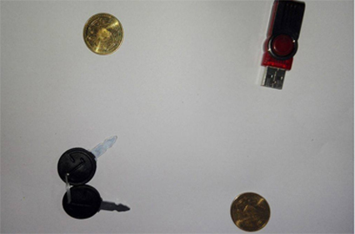
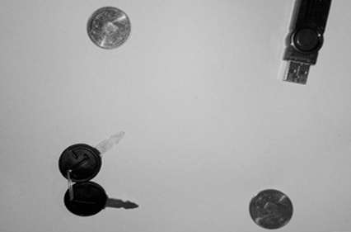
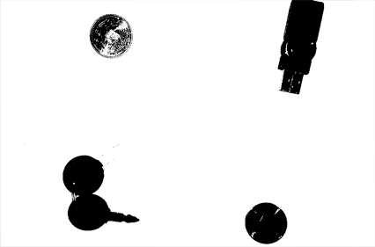
LOCALIZATION

Slide 38
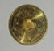
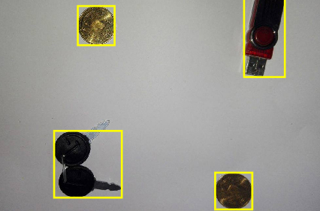
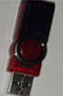
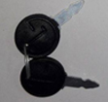
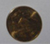
LOCALIZATION

Slide 39
TESTING
SIFT Descriptors extraction
Nearest Cluster Centers for each Descriptors
Bag of Visual Words Histogram Generation
Normalization of Histogram
Prediction of image with the previously trained model

Slide 40
TESTING
scores
0.0010
Trained Model for coin
Max value is for Pendrive
Trained Model for pendrive
0.0999
Trained Model for keys
-0.0132

Slide 41
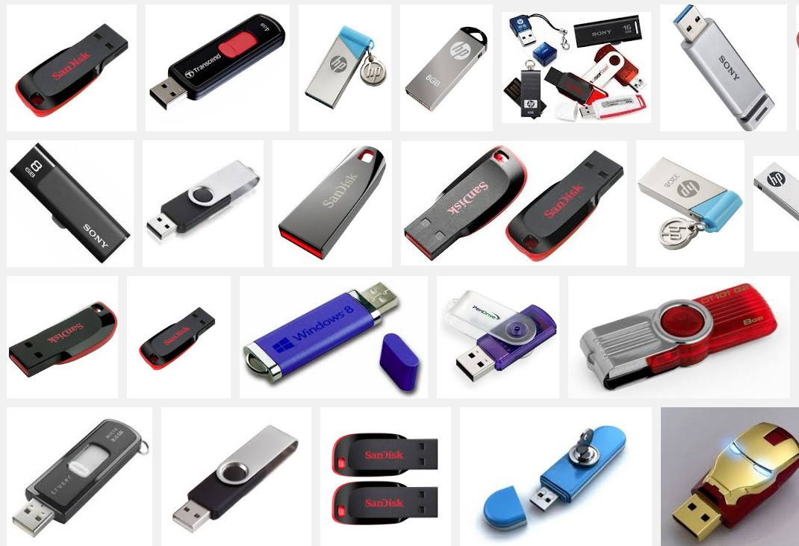
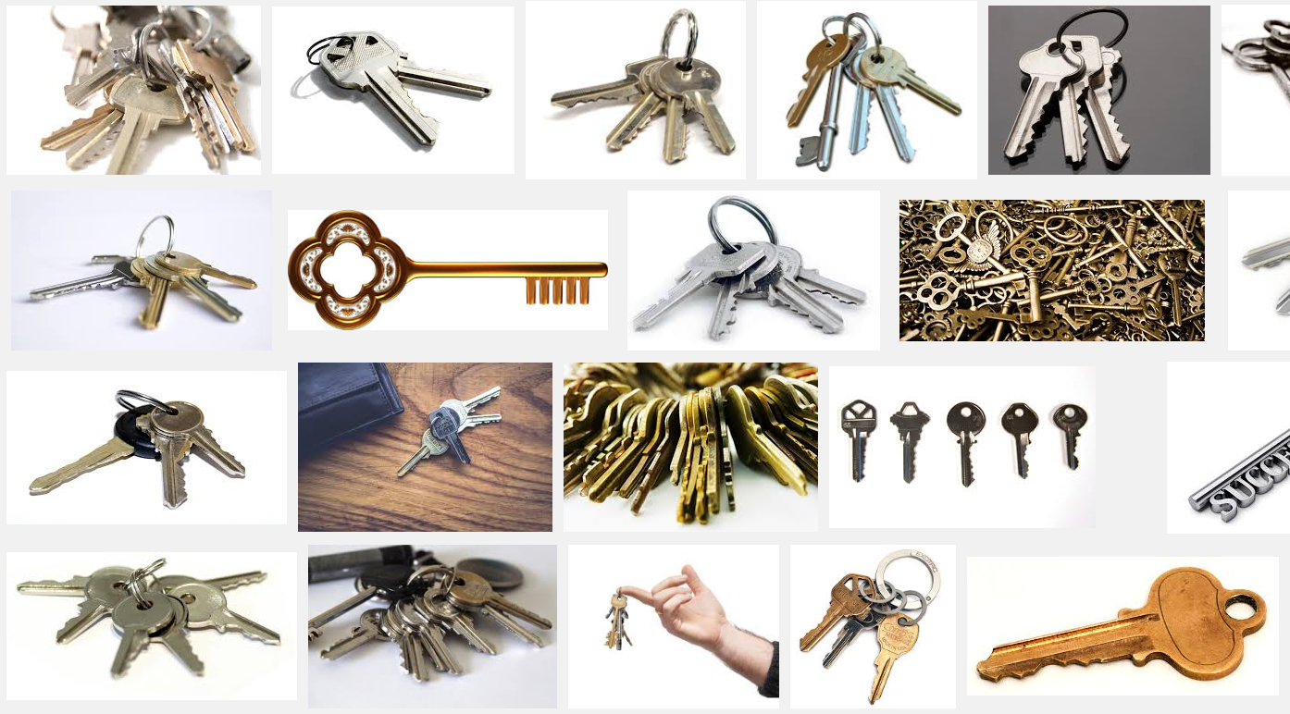
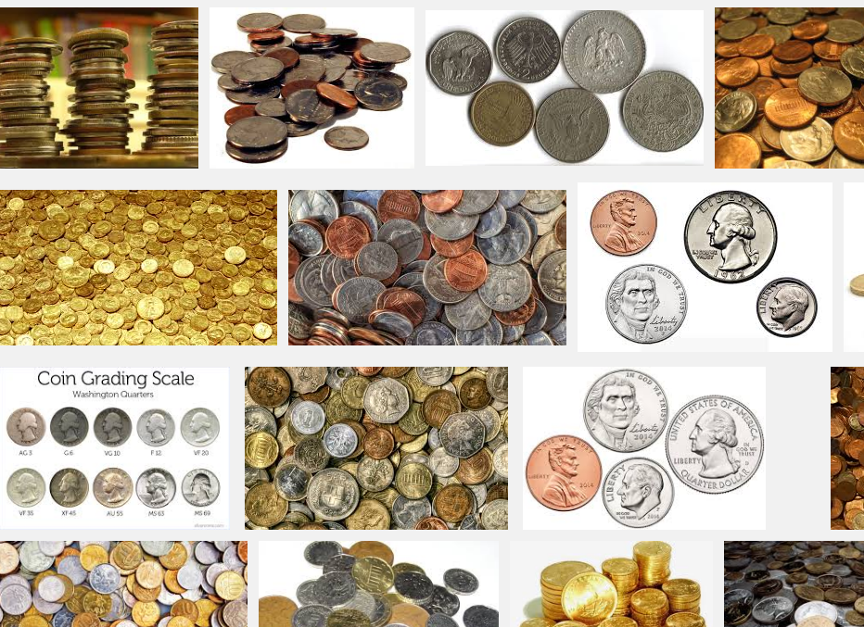
REINFORCEMENT LEARNING
We ask user to correct the mistakes and improve the training model

Slide 42
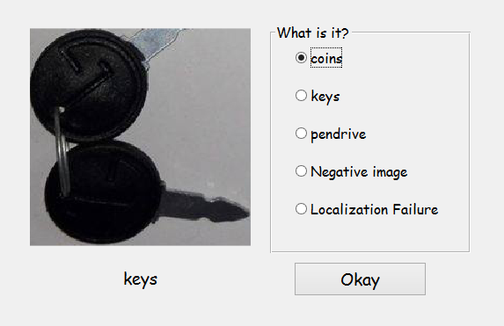
REINFORCEMENT LEARNING
Its category label is stored.
Clustering its features along with training images.
Train the model using SVM.
Update the model.

